Slide 1


Exploratory Data Analysis – (EDA) Project
Tanmay Saxena

Slide 2
INTRODUCTION:
The idea behind analyzing the Zomato dataset is to get an idea about the factors affecting the establishment of different types of restaurant at different places in Bengaluru, aggregate rating of each restaurant, Bengaluru being one such city has more than 12,000 restaurants with restaurants serving dishes from all over the world.
Bengaluru city has thousands of restaurants, pubs, bars, cafe etc. spawning across the city.
These restaurants consists of variety of foods from across the continent.
Even with these many options the saturation is still nowhere at the horizon. Still, opening new restaurants was taxing and these new restaurants were not able to compete with the existing ones in the city.
- Neil Armstrong

Slide 3
PROBLEM STATEMENT
Even with such a large demographic to work with why are new restaurants failing to gain popularity.
This Zomato dataset will help us understand what kind of restaurants have more chances of succeeding in the current scenario.
Does theme or type of food matter for a particular locality?
How do facilities such as online ordering or online table booking affect restaurants popularity?
Do similar themed restaurants have different revenue in different localities?
How does a cost matter?

Slide 4
Features of dataset under analysis
url contains the url of the restaurant in the zomato website
address contains the address of the restaurant in Bengaluru
name contains the name of the restaurant
online_order whether online ordering is available in the restaurant or not
book_table table book option available or not
rate contains the overall rating of the restaurant out of 5
votes contains total number of rating for the restaurant as of the above mentioned date
phone contains the phone number of the restaurant
location contains the neighborhood in which the restaurant is located
rest_type restaurant type
dish_liked dishes people liked in the restaurant
cuisines food styles, separated by comma
approx_cost(for two people) contains the approximate cost for meal for two people
reviews_list list of tuples containing reviews for the restaurant, each tuple
menu_item contains list of menus available in the restaurant
listed_in(type) type of meal

Slide 5
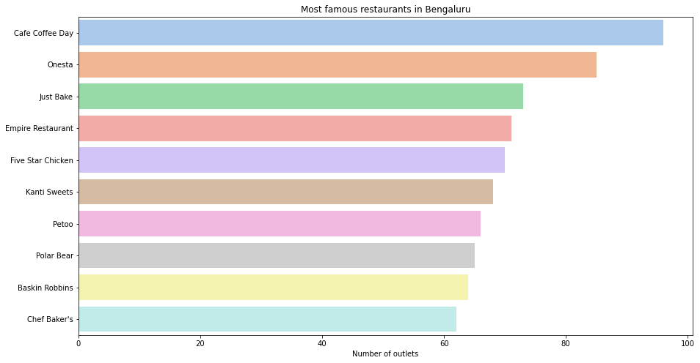
Famous restaurants in Bangalore
Café Coffee Day was the most famous restaurant with more than 90 outlets in the city.
Likewise Onesta, Just Bake, Empire Restaurants are not trailing too far behind in the number of outlets.
These are chain outlets hence are present in almost all the localities of the city.

Slide 6
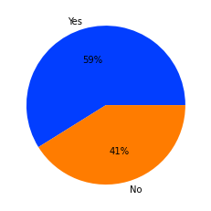
Accepting online orders
Approx 40 percent of the total restaurants in Bengaluru do not accept online orders.
This may be due to insufficient revenue generated by these restaurants due to which they are unable to pay the commission
To zomato for its online services. Zomato may want to give them some concession or incentives to encourage these restaurants
To have online ordering from zomato.

Slide 7
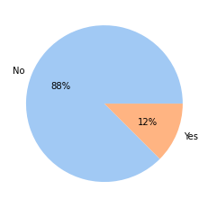
Accepting Table bookings
Approx 2/3rd of the total restaurants in Bengaluru do not accept table bookings.
This may be due to regular cancellations and no show ups or maybe they don't have enough customers.
Zomato can introduce a small charge for table booking and cancellations would cause penalty to the user.

Slide 8
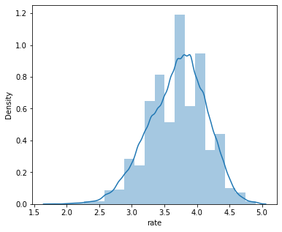
Ratings of Restaurant
From the density plot we can determine the average ratings of restaurants in Bengaluru.
Most restaurants fall within the range of 3.5 to 4.5.
Restaurant has to be exceptional in service and food in order to get a rating of more than 4.5.

Slide 9
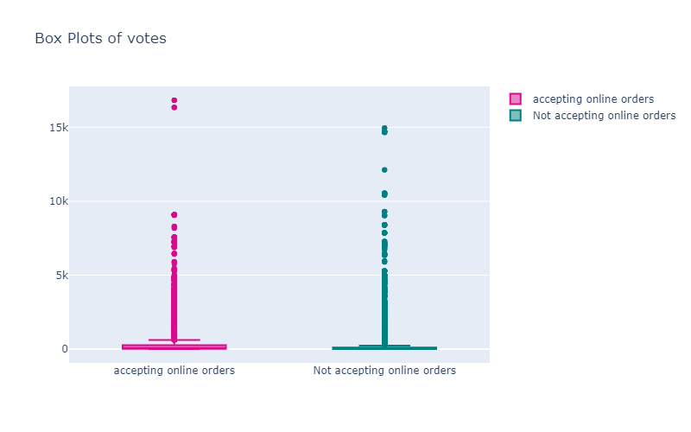

Online orders
We can observe that median number of votes for both categories vary.
Restaurants accepting online orders tend to get more votes from customers as there is a rating option popping up after each order through zomato application.

Slide 10
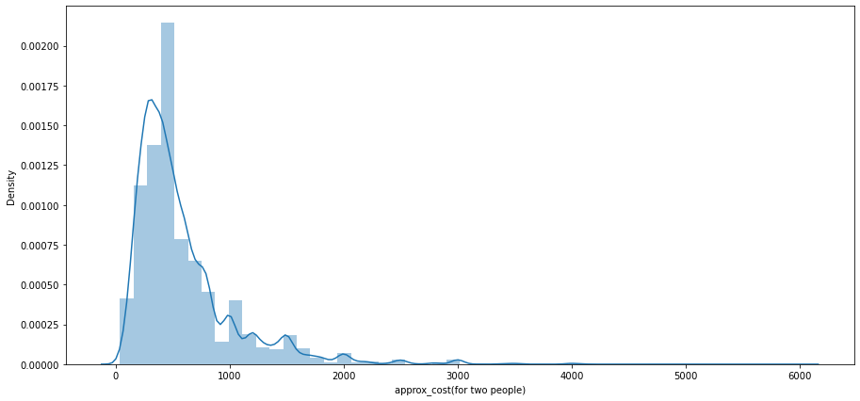
Distribution for cost of two people
A majority of restaurants provide food with an approximate cost of around Rs 500-600 for two people.
This is a reasonable cost as most people in Bengaluru have long working hours and order food from restaurants or dine there.
Having higher cost of dining for two people, for eg above Rs 1000 is not reasonable in the long run.

Slide 11
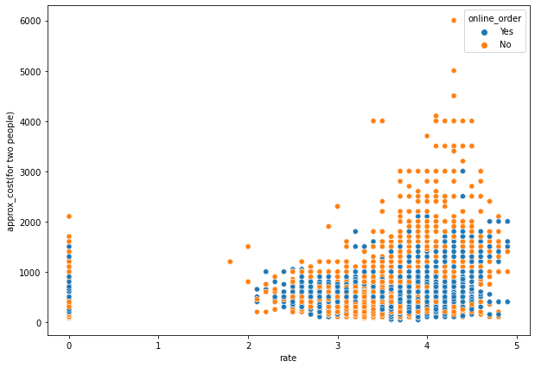
Cost v/s rating analysis
Majority of restaurants with a rating around 4 are low in cost and accept online orders.
There are some restaurants with high cost of dining not present on the Zomato app.
Zomato can checkout these high end restaurants and offer some deal to include online ordering.

Slide 12
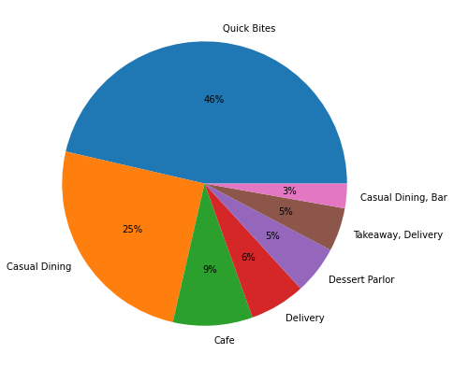
Type of restaurant
Majority of Bangaloreans prefer quick bites due to their busy schedules and sporadic working shifts.
Almost 2/3rd of all restaurants are quick bites or casual dining.
A very small percentage is covered by cafes, delivery, dessert, takeaway or bars.

Slide 13
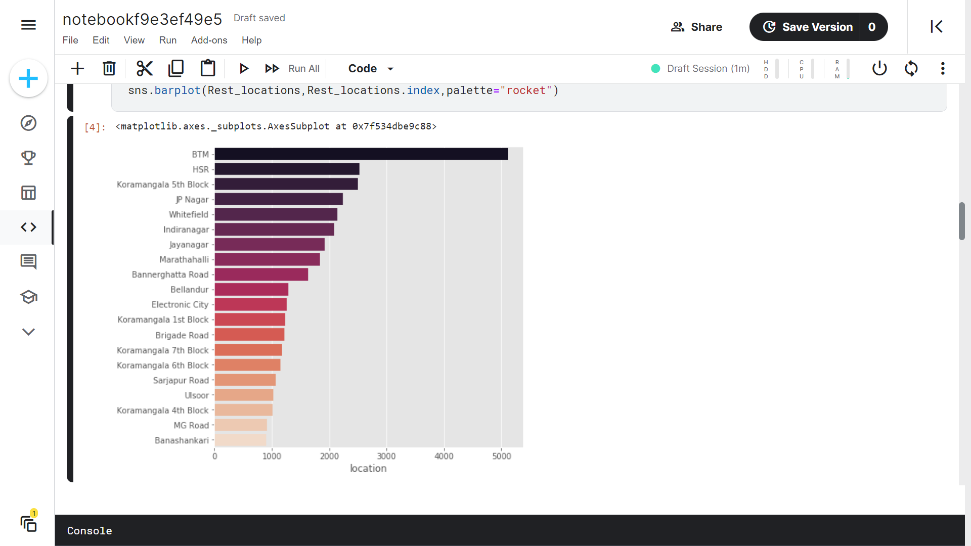
Restaurants based on location
We can see that BTM,HSR and Koramangala 5th block has the most number of restaurants.
BTM dominates the section by having more than 5000 restaurants.

Slide 14
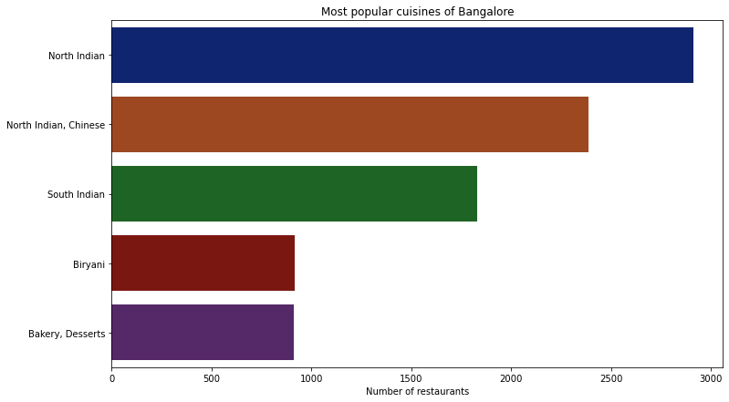
Types of cuisines
We can observe that North Indian, Chinese, South Indian and Biryani are most common.
Upon first glance it seems that Bengaluru is more influenced by North Indian culture than South.

Slide 15
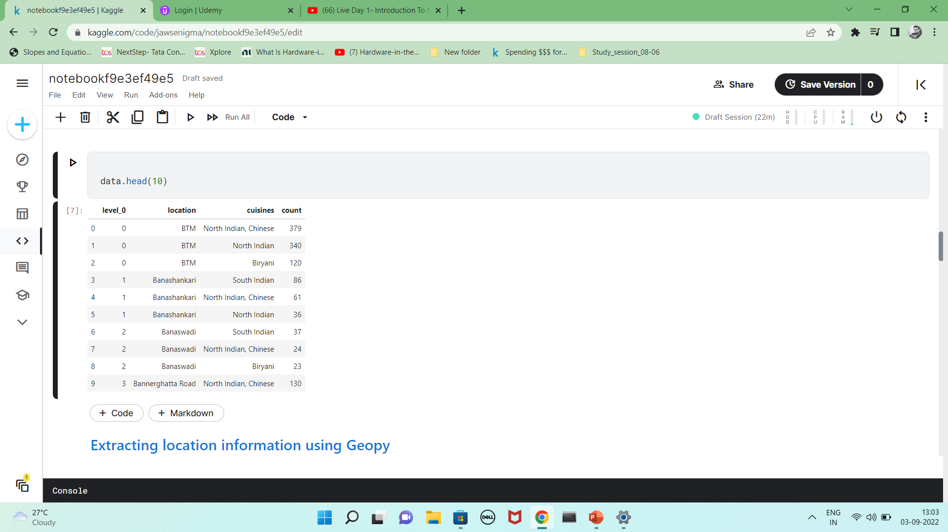
Which are the most common cuisines in each locations?
It is an interesting feature to note that North Indian food is preferred in Bengaluru.
BTM features the most number of cuisines with North Indian dishes topping the list.

Slide 16
Conclusion
Café coffee day was the most famous restaurant with more than 90 outlets in the city.
Approx 40 percent of the total restaurants in Bengaluru do not accept online orders. This may be due to insufficient revenue generated by these restaurants due to which they are unable to pay the commission.
Approx 2/3rd of the total restaurants in Bengaluru do not accept table bookings. This may be due to regular cancellations and no show ups or maybe they don't have enough customers.
Most restaurants fall within the range of 3.5 to 4.5.
Restaurants accepting online orders tend to get more votes from customers as there is a rating option popping up after each order through zomato application.
A majority of restaurants provide food with an approximate cost of around rs 500-600 for two people.
Majority of people in Bengaluru prefer quick bites due to their busy schedules and sporadic working shifts.
BTM dominates the section by having more than 5000 restaurants.
We can observe that north Indian, Chinese, South Indian and biryani are most common cuisines.

Slide 17
Actionable insights
Chain restaurants tend to dominate the market as number of outlets are much more when compared to local restaurants.
Zomato may want to give restaurants with no online services some concession or incentives to encourage them to register in the app for online ordering and other services. Restaurants accepting online orders tend to get more votes from customers as there is a rating option popping up after each order through zomato application.
Zomato can introduce a small charge for table booking and cancellations would cause penalty to the user.
Majority of people in Bengaluru prefer quick bites due to their busy schedules and sporadic working shifts.
Restaurant has to be exceptional in service and food in order to get a rating of more than 4.5.
There are some restaurants with high cost of dining not present on the zomato app. Zomato can checkout these high end restaurants and offer some deal to include online ordering.
BTM, Koramangala and HSR layout has most number of restaurants, still if any new restaurant needs to be opened these places tend to give more exposure and even with less advertisement, user traffic can be more.
Bengaluru is more influenced by north Indian culture than south. Keeping more North Indian cuisines may prove to be a good option for any new restaurant.

